Slide 1
Hiring Process Analytics
Presented By : Rahul Vishwakarma

Slide 2
Description
My task is to analyze the company's hiring process data and draw meaningful insights from it. The hiring process is a crucial function of any company, and understanding trends such as the number of rejections, interviews, job types, and vacancies can provide valuable insights for the hiring department.

Slide 3
Approach
Handling Missing Data: Check if there are any missing values in the dataset. If there are, decide on the best strategy to handle them.
Clubbing Columns: If there are columns with multiple categories that can be combined, do so to simplify your analysis.
Outlier Detection: Check for outliers in the dataset that may skew your analysis.
Removing Outliers: Decide on the best strategy to handle outliers. This could be removing them, replacing them, or leaving them as is, depending on the situation.
Data Summary: After cleaning and preparing your data, summarize your findings. This could involve calculating averages, medians, or other statistical measures. It could also involve creating visualizations to better understand the data.

Slide 4
Hiring Process Analytics

Slide 5
DATA CLEANING
In the Event_name there 4 distinct types “Male”, “Female” ,” Don’t want to say”, “-”. This is Categorical data. “- ” changing to “Don’t want to say ”
Application Id 114584 is replace by mean of offered Salary is 51241 because it had “-”
Deleted 4 Row with that contains outliers
Statistical measures
Max Salary = 400000
Min Salary = 100
Median Salary = 49628
Mean Salary = 49983.20
Q1 = 25463
Q3 = 74438
IQR (Interquartile Range) = 48974.25
Upper Bond : 147876
Lower Bond : -48002

Slide 6
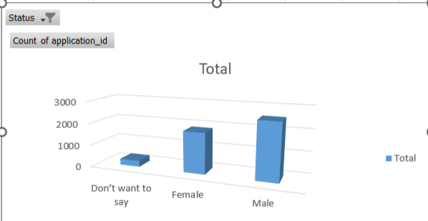
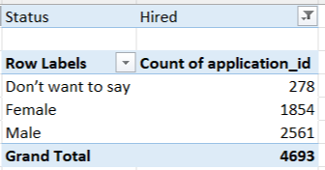
Determine the gender distribution of hires. How many males and females have been hired by the company?

Slide 7
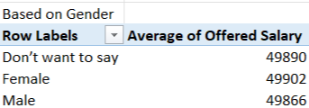
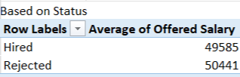
What is the average salary offered by this company? Use Excel functions to calculate this.
“The salary analysis is based on the average offered salaries provided by the company. The overall average offered salary, across all statuses and genders, is ₹49,880. The average salary for candidates actually hired by the company is ₹49,585.”

Slide 8
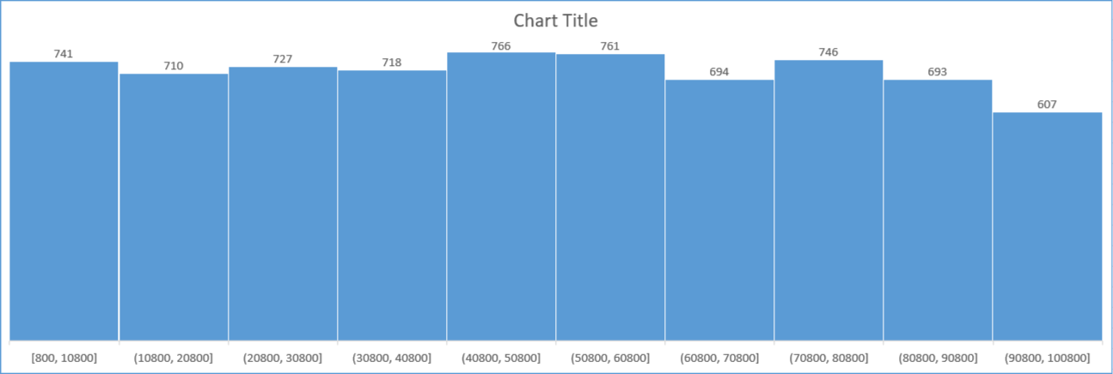
Create class intervals for the salaries in the company. This will help you understand the salary distribution.
The chart above illustrates how offered salaries are distributed across defined salary ranges (class intervals). Each bar represents a salary range, and its height shows how many candidates fall within that range.
The salary ranges start from ₹800 to ₹10,800 and increase in equal intervals of ₹10,000.
The highest frequency occurs in the ₹40,800–₹50,800 and ₹50,800–₹60,800 ranges, with 766 and 761 candidates respectively — indicating that most offered salaries cluster around the mid-range.
The lowest frequency is in the highest salary band, ₹90,800–₹100,800, with 607 candidates, showing fewer high offers.
The distribution appears fairly balanced, with a slight concentration in the mid-salary ranges.
The salary distribution shows a clear mid-range cluster (₹40,800–₹60,800) where most offers fall, fewer candidates in the lowest (₹800–₹10,800) and highest (₹90,800–₹100,800) bands indicating rare low or high offers, and an overall balanced spread suggesting salaries align well with role levels and market standards.

Slide 9
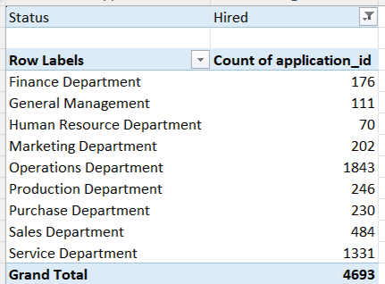
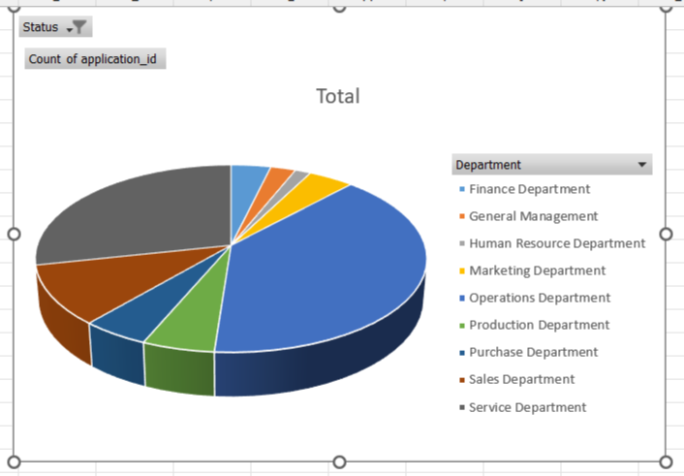
Use a pie chart, bar graph, or any other suitable visualization to show the proportion of people working in different departments.
Most hires are concentrated in the Operations and Service Departments, while departments like HR and General Management have the fewest hires, highlighting where the company’s main workforce demand lies.

Slide 10
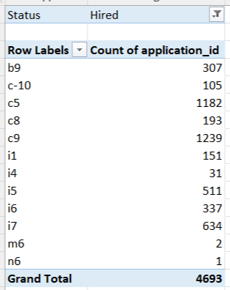
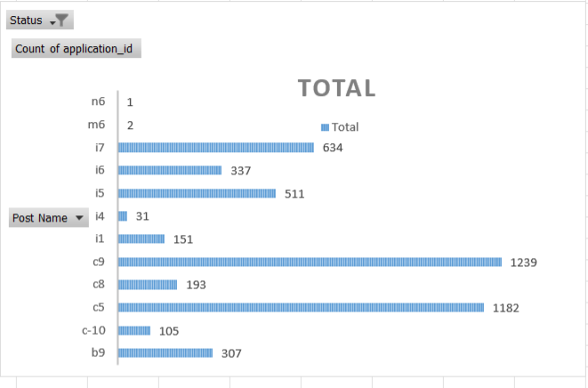
Use a chart or graph to represent the different position tiers within the company. This will help you understand the distribution of positions across different tiers.
Most hires are for posts c5, c9, i7, and i5, showing these positions drive the bulk of recruitment while roles like m6 and n6 have minimal hiring.

Slide 11
Thank You

